Slide 1
Stress Testing
Credit Risk Management

Slide 2
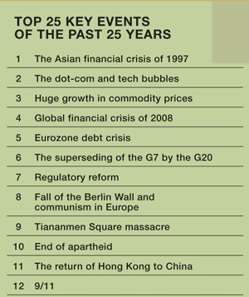
Definition
A stress test is a comprehensive process where statistical tools are used as a guide to assess how adverse macroeconomic scenarios may affect a bank’s resilience.
Federal reserve United States, European National Bank, Bank of England etc. do an annual stress testing assessment and publish the results based on the scenarios provided the authorities,

Slide 3
Types of Stress Tests
Scenario Analysis
Developing Stress Scenarios
Identifying and creating adverse scenarios based on historical data and expert judgment.
Evaluating Scenarios
Assessing the impact of scenarios on different variables.
Sensitivity Analysis
Identifying Key Variables
Determining which variables have the most significant impact on outcomes.
Analyzing Impact
Varying key parameters to observe changes in results.

Slide 4
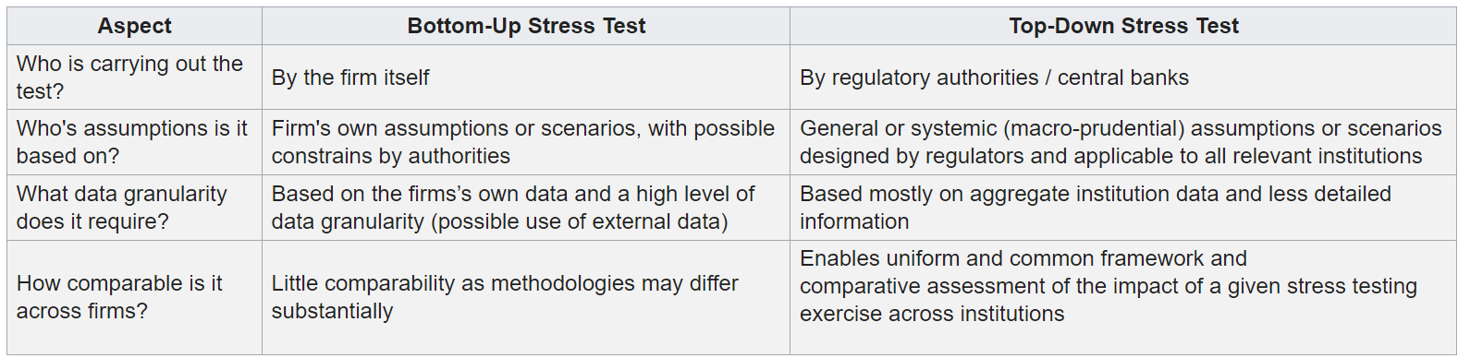
Different Approaches to Stress Testing

Slide 5
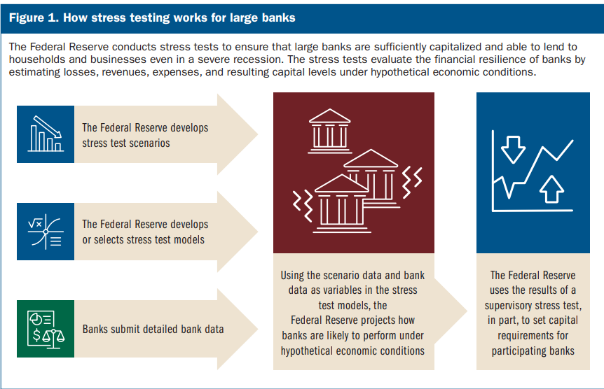

Slide 6
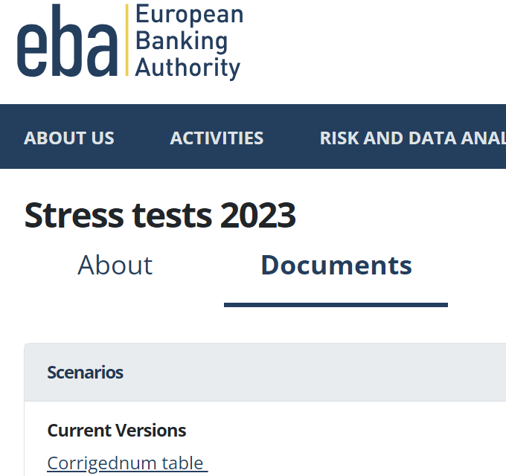
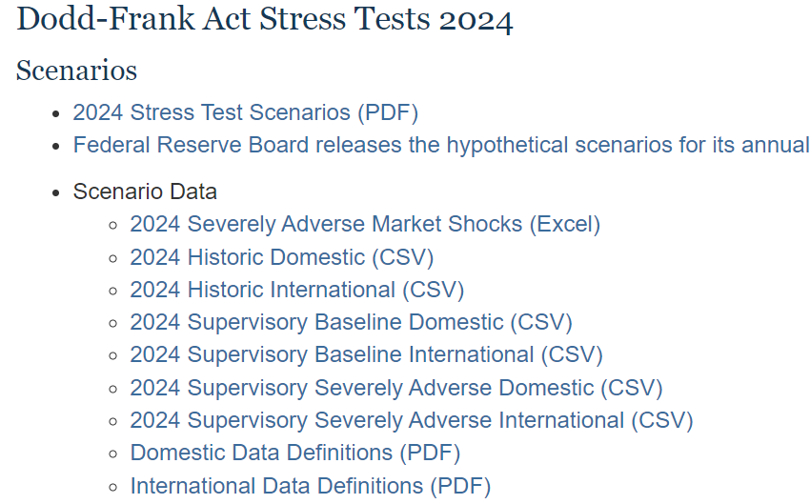
Reforms and Stress/Shock Scenarios
Regulatory bodies like Bank of England, Federal Reserve, European Banking Authority hand out Stress scenarios to the banks annually

Slide 7
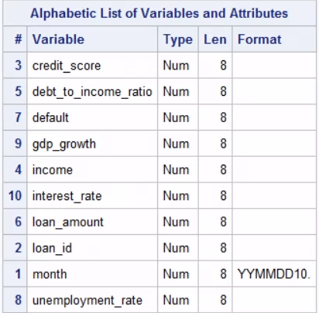
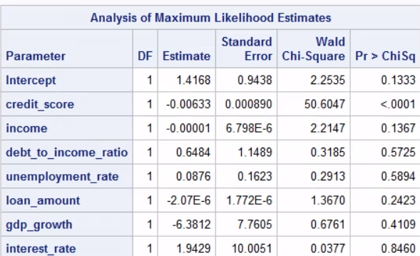
Stress Testing – Example: Loss Estimation for a bank in SAS
Simulated a table that contains loan portfolio with a few macro economic indicators
Logistic Regression model of the simulated variable data

Slide 8
Stress Scenario Simulation
data stress_scenario;
set loan_portfolio;
unemployment_rate = unemployment_rate + 2;
gdp_growth = gdp_growth - 3;
interest_rate = interest_rate + 1;
run;
Stress Scenarios shared by regulators: 2024-Table_3A_Supervisory_Baseline_Domestic.csv
Source: https://www.federalreserve.gov/supervisionreg/dfa-stress-tests-2024.htm

Slide 9
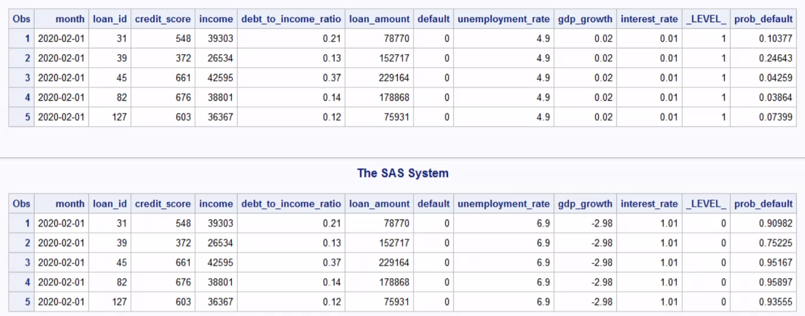
Baseline Scenario
Severe Scenario

Slide 10
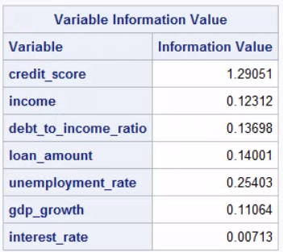
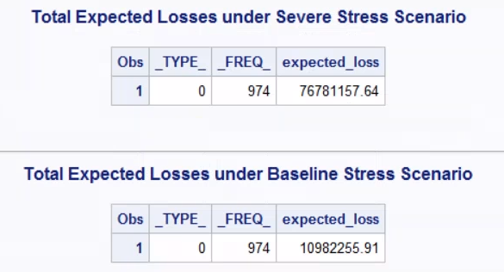
Calculating Expected Loss over Loan Portfolio
data expected_losses;
set stressed_pd;
loss_given_default= 0.60;
expected_loss = loan_amount * prob_default *loss_given_default;
run;
Assumptions:
Loss given Default is 0.6 (Hardcoded)
Banks expect to lose 60% of the loan amount(exposed amount) considering 40% covered by collateral
Exposure at default is total loan amount in this case.
Expected loss = PD *LGD *EAD

Slide 11
Other Statistical Concepts in Stress Testing:
Monte Carlo Simulations
Statistical Techniques in Macro Economic Scenario Analysis – VAR and GVAR
Vector Autoregressive Model
The vector autoregressive (VAR) model is a workhouse multivariate time series model that relates current observations of a variable with past observations of itself and past observations of other variables in the system.
Proc VarMax in SAS
Global Vector Autoregressive Model
The Global Vector Autoregressive (GVAR) approach provides a relatively simple yet effective way of modelling interactions in a complex high-dimensional system such as the global economy.
Reverse Stress Testing

Slide 12
Benefits of Stress Testing
Risk Management:
Identifying vulnerabilities
Enhanced risk awareness
Regulatory compliance
Strategic planning
Informed decision making
Scenario analysis
Stakeholder confidence
Quantitative insights
Loss estimation
Impact assessment
Credit risk mitigation
Portfolio optimization
Risk based pricing

Slide 13
Sources
https://www.openriskmanual.org/wiki/Bottom-Up_versus_Top-Down_Stress_Test
https://www.imf.org/external/np/seminars/eng/2006/stress/pdf/jh.pdf
https://onlinelibrary.wiley.com/doi/pdf/10.1111/joes.12095

Slide 14
Thank you
"The key to effective stress testing is not predicting the future but understanding the range of possible outcomes and preparing for them.“
- Mervyn King (Economist, Bank of England)

